Slide 1

Navigation aid for blind people
Mounir Bousbia-Salah · Maamar Bettayeb · Allal Larbi

Slide 2
Link To Paper: https://link.springer.com/article/10.1007/s10846-011-9555-7
DOI : 10.1007/s10846-011-9555-7
Published : 10th May, 2011
Presented By:
Ishrat Jahan Ananya | 1631636042
Shadab Hafiz Chowdhury | 1631335642
Sarah Suad | 1632282642
Nabiul Hoque Khandakar | 1631164642

Slide 3
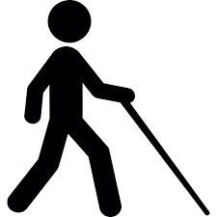
INTRODUCTION
Visual impairment creates dependence on others for navigation and object locations.
Visually impaired individual must overcome the problem to guarantee social inclusion
SOLUTION?
A navigation aid based on microcontroller with a synthetic speech output.

Slide 4
Some Notable work
Guide Cane, a device which uses echolocation to detect objects directly in front of the cane and steer the user away from them.
Canes with GPS integration and other basic sensors.
Navigation aid for blind headset by Dayle Swensen,
However, all of them have some issue or the other. Perhaps it disrupts the navigation method, can only detect objects on the ground or simply not efficient or cost effective enough.

Slide 5
Proposed System
In Record mode, blind walks the route of interest, and the aid measures the distance travelled and presses a key. This records the distance travelled in mcu or the left turn taken
In playback mode, aid measures the distance travelled and when this is equal to that stored in the memory for that particular section of the route, a decision word generated by the synthesizer is given to the blind.
In the reverse direction, the procedure is exactly the same except that the route information stored in the memory is used in reverse order, and that right and left are interchanged.
System
Playback
Forward
Reverse
Record

Slide 6
PROPOSED SYSTEM
Decisions
Turn Left
Turn Right
Crossroads
Crossroads junction
Pedestrian crossings
Steps
Pause
Stop

Slide 7
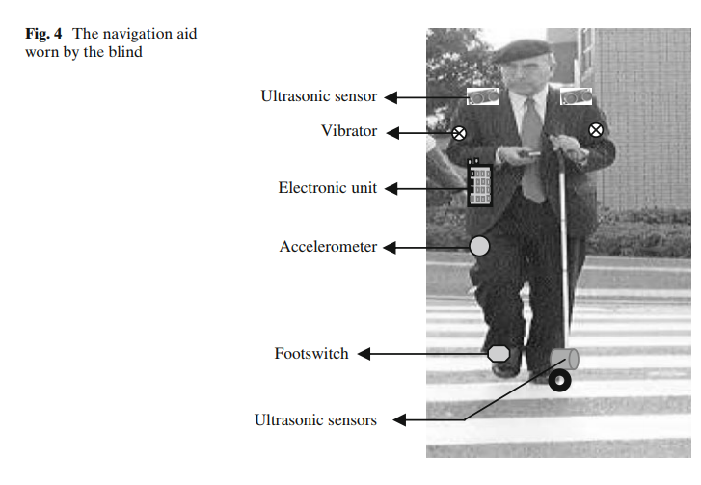
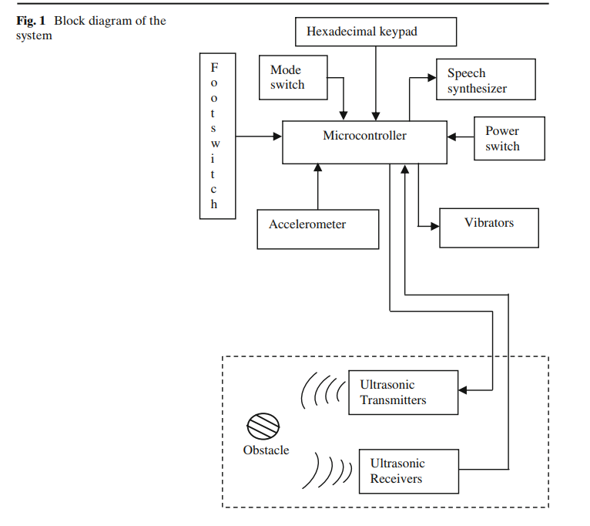

Slide 8
PROPOSED SYSTEM
The cane is equipped with ultrasonic sensors and wheels. It notifies whether any obstacle is in the middle of the walking direction.
The speech synthesizer chip with a small vocabulary tells then the blind person about travelled distance, location and decision to make
The footswitch is used to allow the mpu to provide frequent corrections of drift effects because the accelerometer results in large errors.
The keypad is used to give input by the user. It can also have braille symbols if necessary.
Accelerometer measures acceleration

Slide 9
Object Detection
Obstacle detection system is mainly done using ultrasonic signals. There are two vibrators mounted on the shoulder and an ultrasonic cane.
The top part is divided into two : one transmits signals the other receives the echo.
The information is then passed to the microcontroller which calculates the time between pulse transmission and received echo.
The comparison from both signals corresponds to the distance between the obstacle and the user.
The cane works in the same way to detect obstacles on the ground. Finally audio output is provided through a headset to alert the user of any obstacles in front.

Slide 10
Thank you!

